Slide 1

A Hybrid Framework for Real-Time Human Coordination and Predictive Maintenance in Multi-Agent Systems
Researcher: Izhar Oswaldo Escudero Ornelas
RA: Zhongyi Wang
School of Internet of Things
December, 2025.

Slide 2
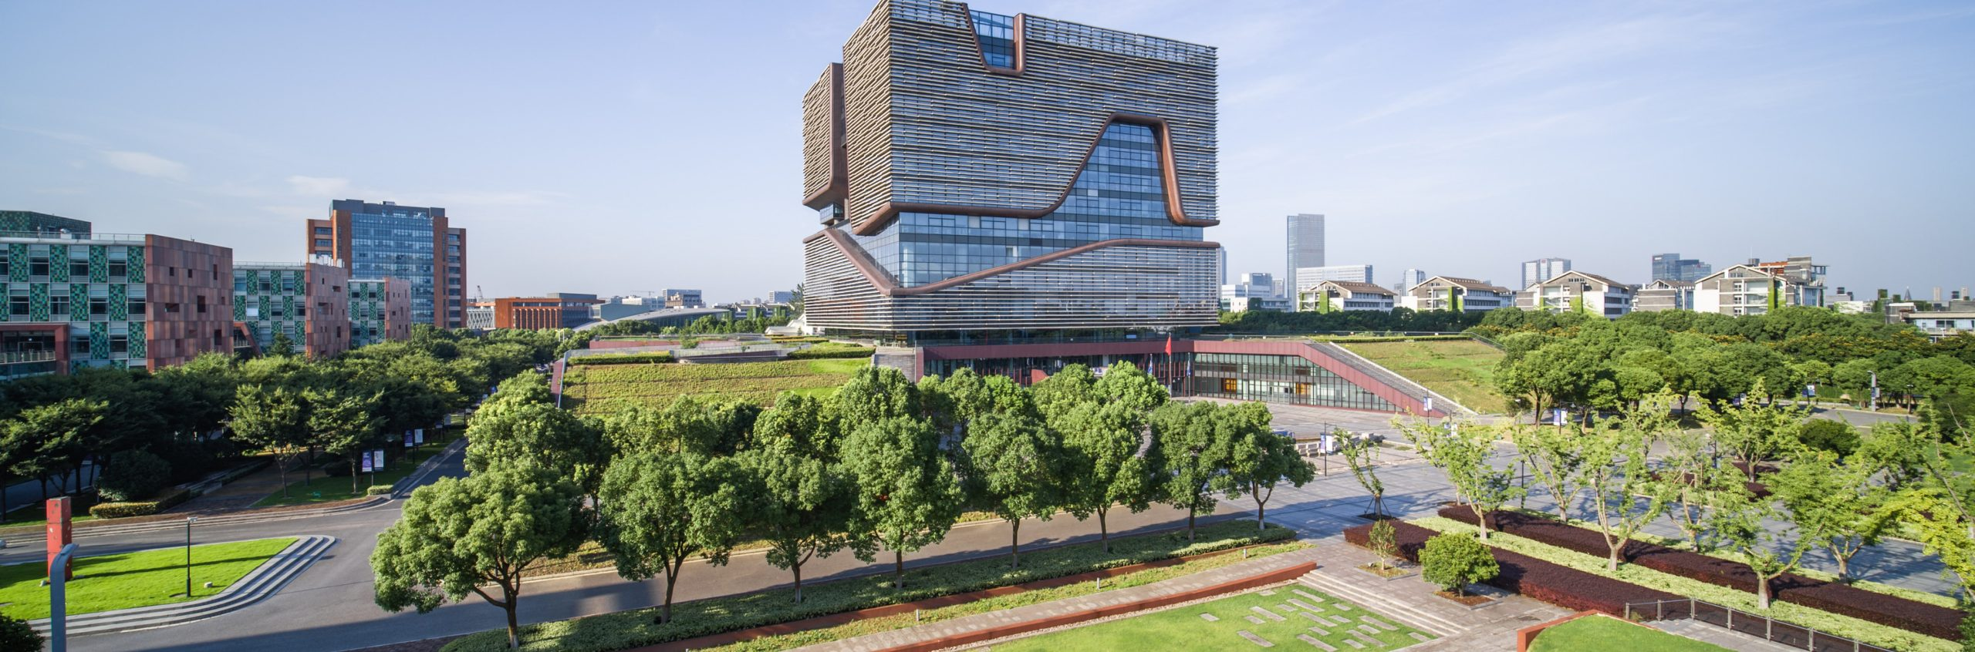
Contents
Background
Literature Review
Methodology
Main Findings
Conclusion

Slide 3
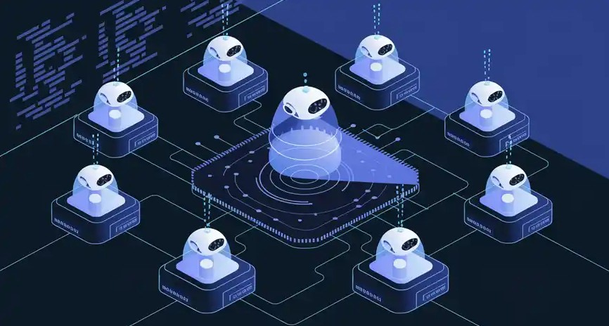
Background
MAS Design Flaw: Existing Multi-Agent Systems (MAS) in manufacturing prioritize full autonomy, leading to a critical design flaw where they exclude real-time human expertise and intervention, reducing adaptability in dynamic, high-stakes scenarios.
PdM Limitation: Traditional Predictive Maintenance (PdM) systems, despite leveraging IIoT and ML, are predominantly reactive and rely solely on historical data, lacking a mechanism to incorporate real-time human contextual knowledge.
The Hybrid Solution: The absence of a bidirectional communication channel between autonomous computational models (MAS/PdM) and human operators results in inefficiencies, reduced trust, and limits the overall effectiveness of advanced industrial systems.

Slide 4

Current Challenges
Exclusion of Human Expertise in MAS
Reactive Nature of PdM
Lack of Unified Frameworks
Notes:
Exclusion of Human Expertise in MAS: Existing Multi-Agent Systems (MAS) prioritize full autonomy, critically excluding real-time human contextual knowledge and intervention, which reduces system adaptability.
Reactive Nature of PdM: Traditional Predictive Maintenance (PdM) relies solely on historical data, operating reactively without a mechanism for incorporating real-time human insights, limiting effectiveness and trust.
Lack of Unified Frameworks: There is a critical gap in frameworks that seamlessly integrate Human-in-the-Loop (HITL) systems within a complex MAS for tasks like predictive maintenance.

Slide 5

Literature Review
Lack of Integrated Frameworks: There is a fundamental lack of frameworks that seamlessly integrate real-time human decision-making with autonomous agents within a unified architecture, particularly for demanding tasks like predictive maintenance.
Untapped Bidirectional Communication: Current Human-in-the-Loop (HITL) implementations largely lack robust bidirectional communication mechanisms, treating human operators as external overseers rather than integral, intelligent agents within the system.
Underexplored PdM-HITL Integration: There is a significant limitation due to the underexplored integration of modern Predictive Maintenance (PdM) systems with HITL frameworks within an overarching Multi-Agent System (MAS).

Slide 6
Project Objectives
Hybrid Architecture: Unify MAS, Human Coordination, and AI-driven PdM.
Symbiotic Relationship: Harmonize AI precision with human contextual awareness for superior performance.
Bidirectional Protocols: Design robust communication to allow human operators to refine AI predictions in real-time.
Adaptive Learning: Implement Reinforcement Learning (RL) policy updates based on operational feedback.
Validate Efficacy: Empirically demonstrate ability to reduce unplanned downtime/costs and enhance accuracy/trust.

Slide 7
Methodology
The research was structured using a methodical Six-Phase Framework for systematic development and validation of the IAPM framework:
System Modeling & Agent Definition: Design the hybrid MAS architecture using ABMS tools (AnyLogic/NetLogo), defining agent roles and interaction protocols.
Real-Time Data Integration: Establish a sensor data pipeline to stream real-time operational data (e.g., from the CNC milling machine) into the MAS.
Fault Prediction & Human-AI Collaboration: Train LSTM networks on data to forecast failures and implement a human-in-the-loop dashboard for collaboration.
Proactive Maintenance Scheduling: Develop optimization algorithms to prioritize maintenance based on failure severity, resources, and production schedules.
Continuous Monitoring & Feedback Loops: Implement a dynamic feedback loop to update RL policies and ABMS rules using human operational input and post-maintenance data.
Validation & Analysis: Rigorously evaluate the framework's performance using quantitative and qualitative metrics.

Slide 8
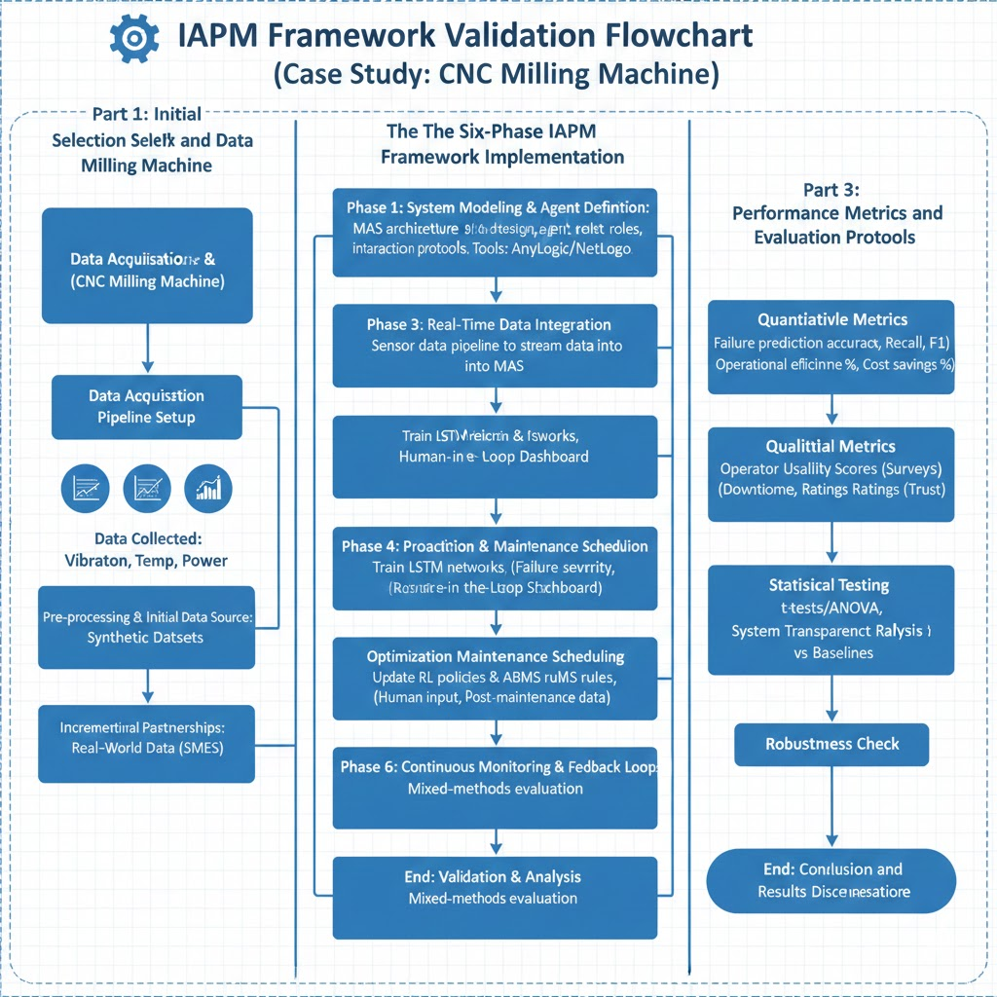
Methodology

Slide 9
Case Study
Case Study Focus: The efficacy of the IAPM framework was validated using a comprehensive mixed-methods approach, with a Spot Welding Machine as the primary case study.
Rationale for Selection: The spot welding machine was selected due to its representative nature within modern manufacturing, its reliance on multiple components susceptible to wear and failure, and its suitability for real-time sensor data collection.
Data Inputs: Data collected included key operational parameters such as vibration, temperature, and power consumption, which are strong indicators of machine health.
Data Strategy: The study initially prioritized synthetic datasets validated against industry benchmarks, with incremental partnerships pursued for later-stage acquisition of real-world data from local SMEs.

Slide 10

Main Findings
Superior Performance: The IAPM framework significantly outperformed baselines, achieving an F1-score >0.85 and projected 15–20% downtime reduction.
Effective Human-AI Synergy: Bidirectional human refinement minimized false alarms by 30-40%, fostering high operator trust and usability.
Hybrid Resilience: The ABMS-RL hybrid confirmed stability, preventing unstable decisions and providing a resilient model superior to purely autonomous systems.

Slide 11

Future Directions
Framework Validation in Diverse Environments
Advanced RL Algorithm Investigation
Long-Term Human-AI Impact Analysis
Notes:
Framework Validation in Diverse Environments: Future work should focus on validating the IAPM framework in different industrial environments (beyond the single CNC milling machine case study) and with a larger volume of proprietary, real-world data.
Advanced RL Algorithm Investigation: Further investigation is needed into new Reinforcement Learning algorithms optimized specifically for multi-agent industrial settings.
Long-Term Human-AI Impact Analysis: Research should explore the long-term effects of human-AI collaboration on key factors, including operational efficiency, operator trust, and worker satisfaction.

Slide 12

Conclusion
The research successfully validated the novel Intelligent Agent-Based Predictive Maintenance (IAPM) framework. This hybrid model unifies AI-driven analytics with real-time human-in-the-loop decision-making. The IAPM framework demonstrated significant operational improvement , achieving a projected 15–20% reduction in unplanned downtime and a 20–30% reduction in maintenance costs. The empirical validation confirmed that bidirectional communication protocols enabled human operators to refine AI predictions, minimizing false alarms by 30–40%. Ultimately, the core contribution is the validation of the human-AI symbiosis model, proving that integrating human operators as decision-makers enhances system resilience, fosters trust, and offers a scalable solution for Industry 4.0.

Slide 13

References

Slide 14

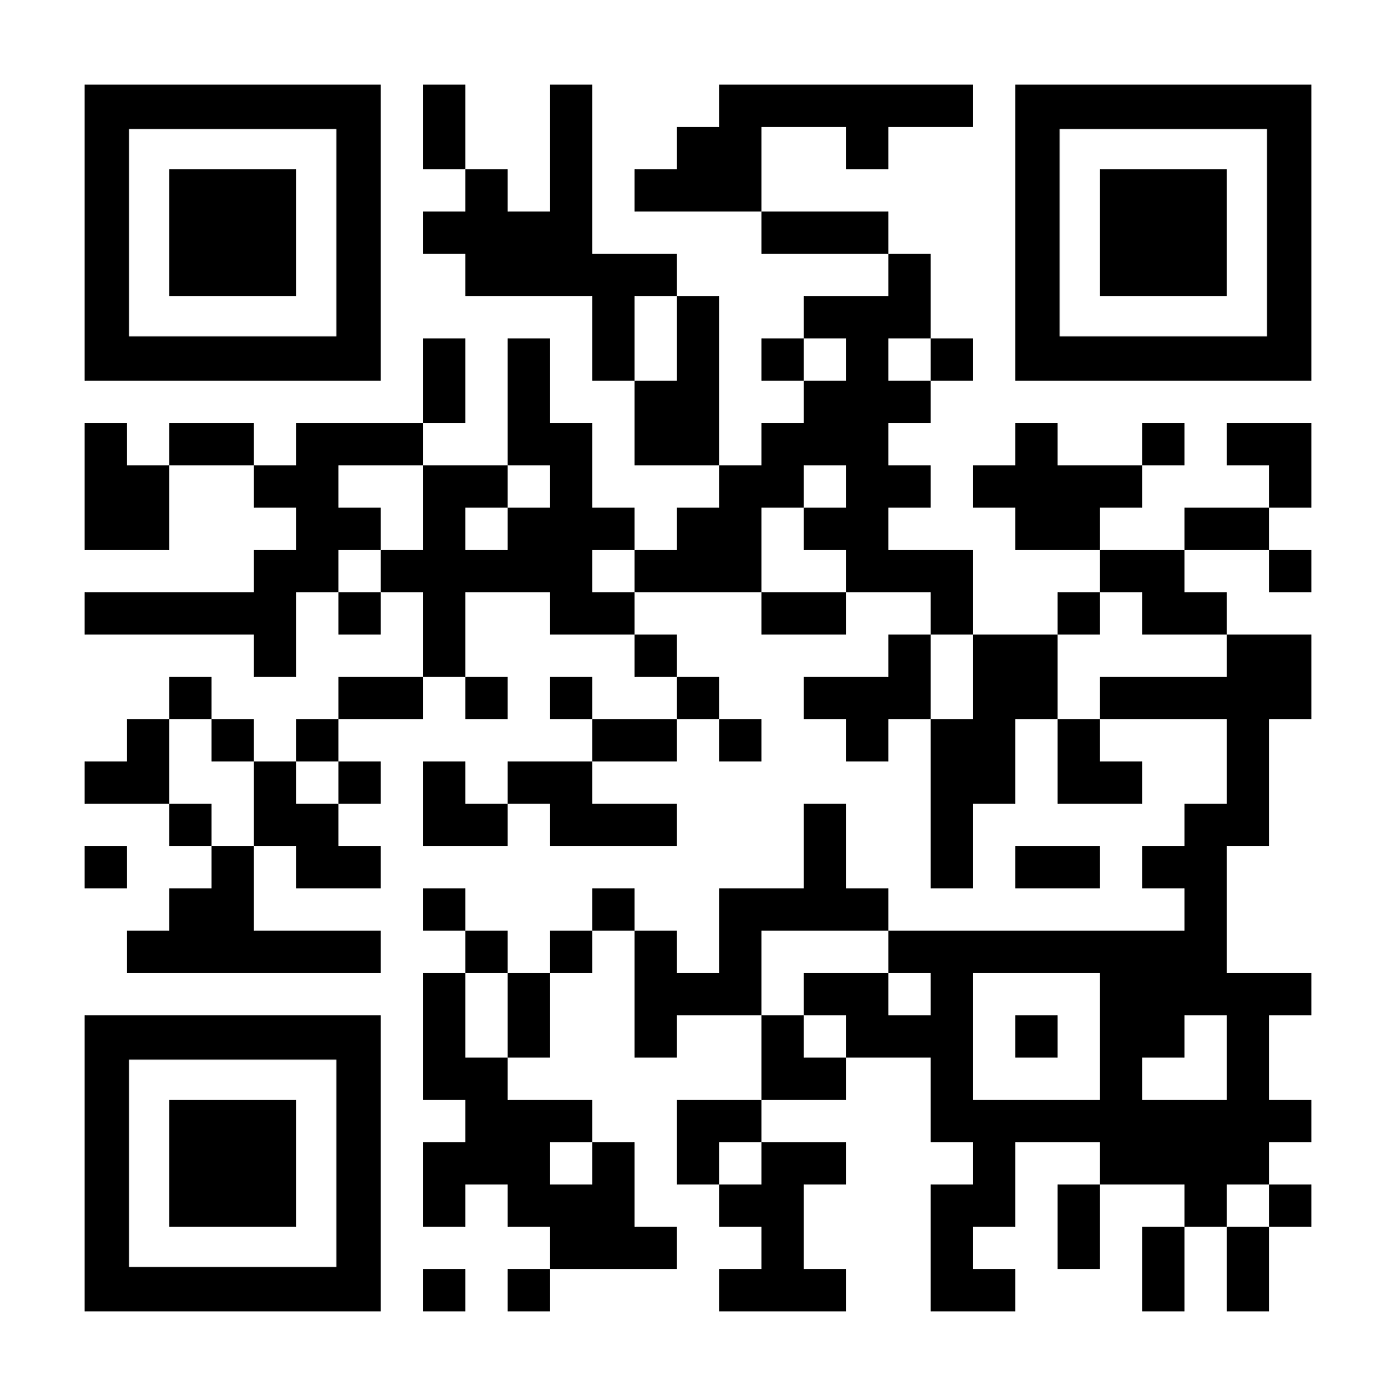

THANK YOU
Visit us
FOLLOW us
www.xjtlu.edu.cn
@xjtlu
Notes:
Title: Uppercase, Calibri size 60, XJTLU Navy

